Slide 1
API
APIs with Python/Pandas
Part 1

Slide 2
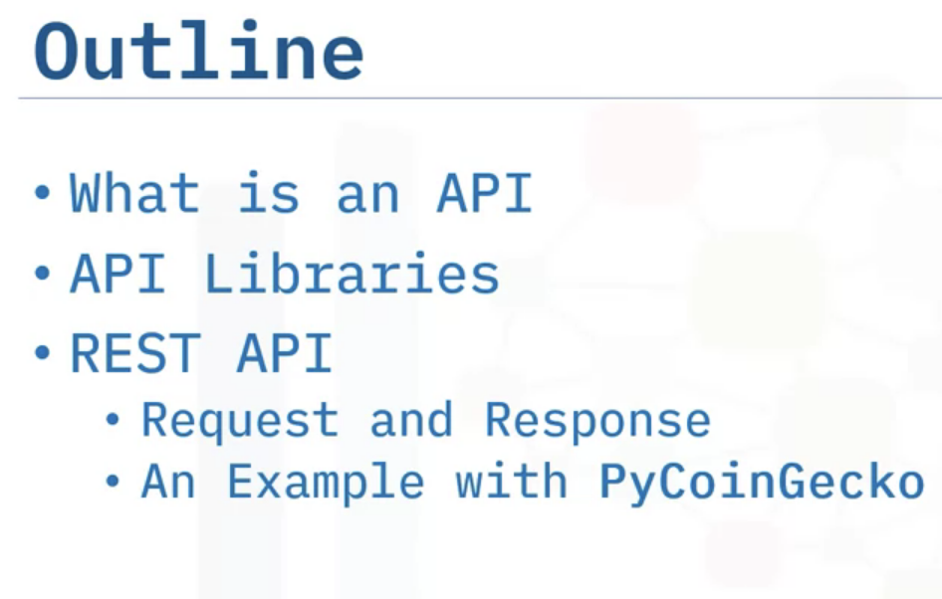
API : Application Program Interface

Slide 3
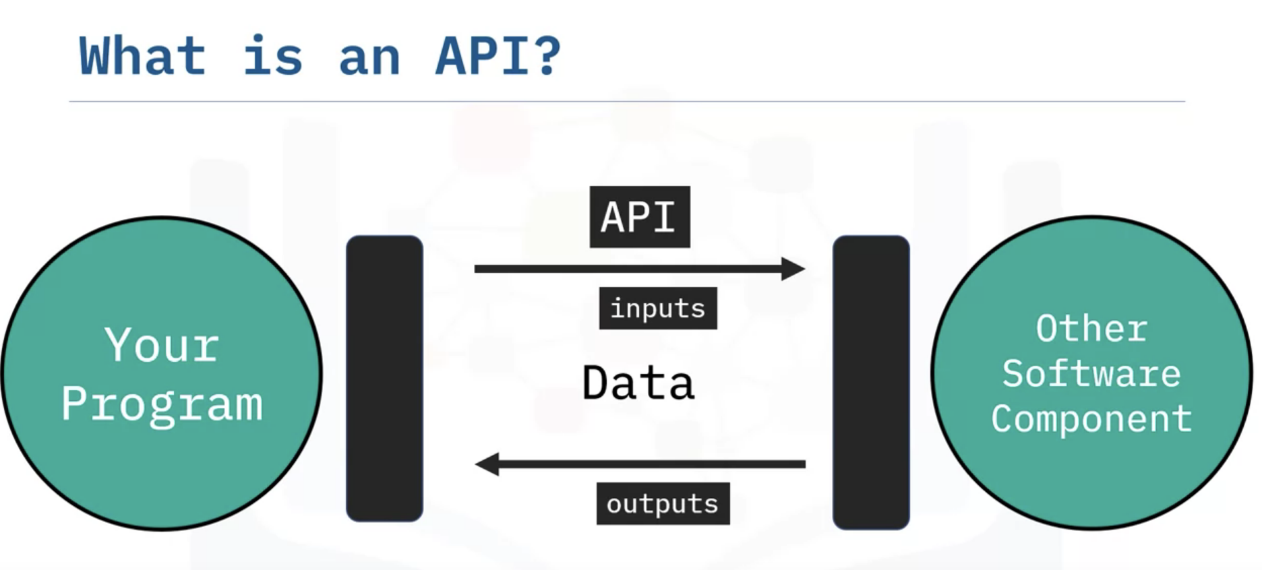
Lets us communicate with our program to other software[written in any language].

Slide 4
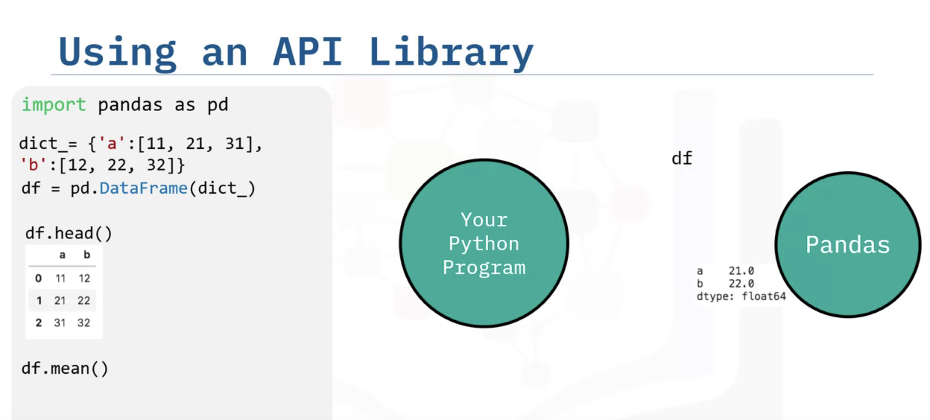
By using pandas API instace we can pass df.head() and in return pandas will provide first 5 rows of the dataframe (head().

Slide 5
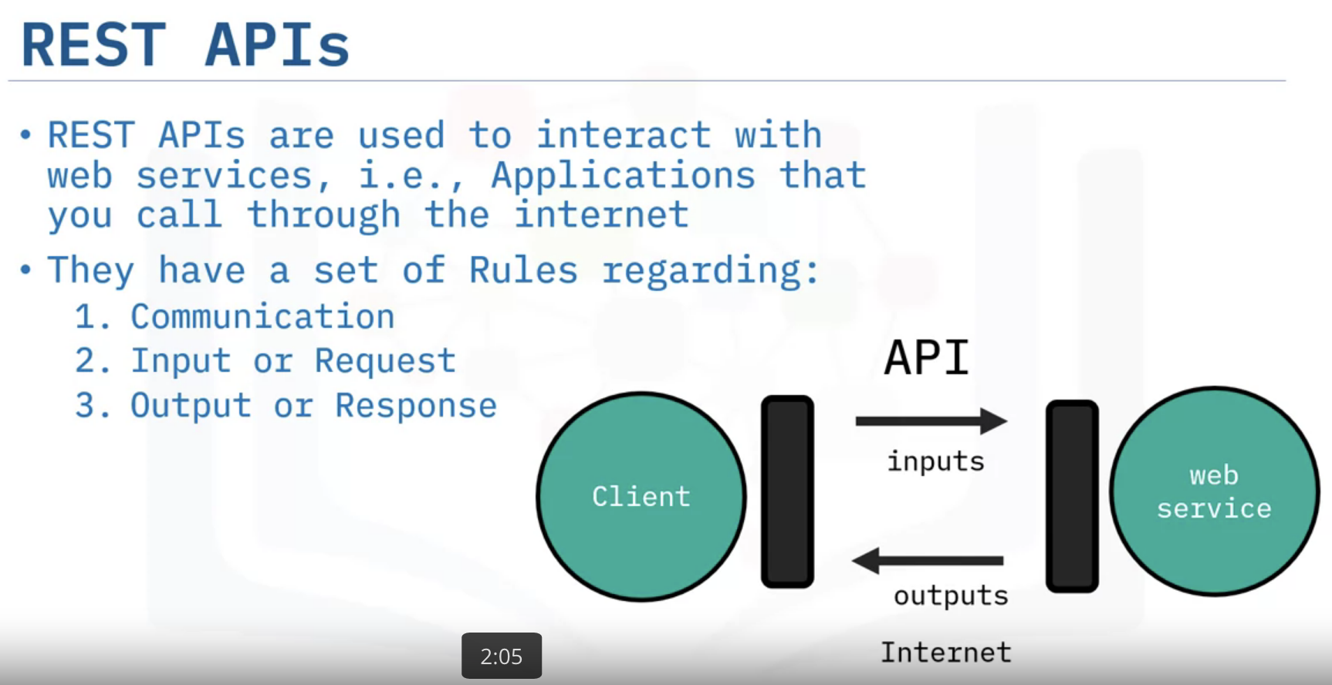
REST APIs are another popular type of API; they allow you to communicate through the internet letting you to take advantage of resources like storage, access more data, artificial intelligent algorithms, and much more.
The RE stands for Representational, the S stands for State, the T stand for Transfer.

Slide 6
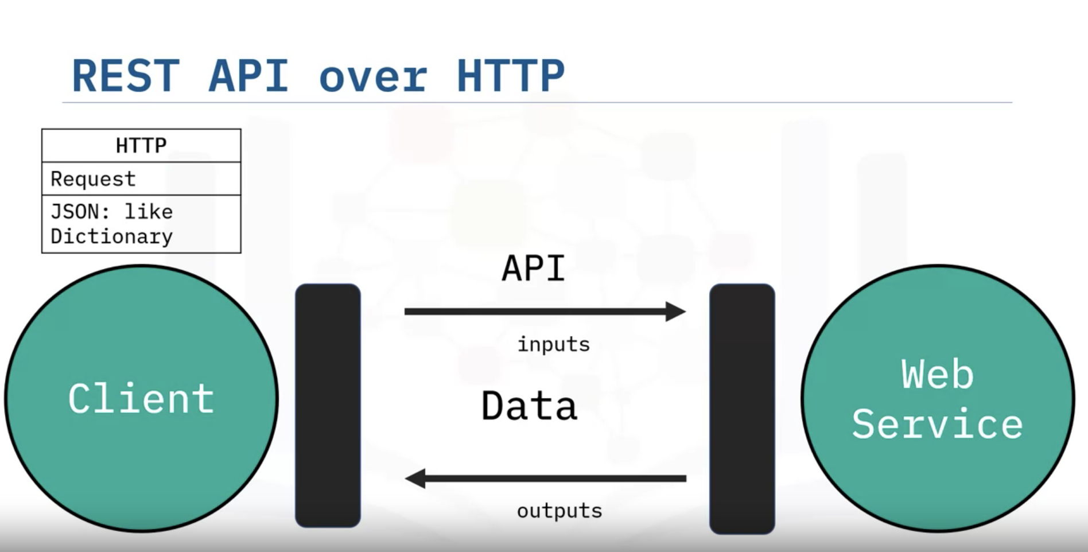
You or your code - client. The web service - resource.
The client finds the service via an endpoint. The client sends requests to the resource and the response to the client.
HTTP methods are a way of transmitting data over the internet.
We tell the Rest APIs what to do by sending a request. The request is usually communicated via an HTTP message.
The HTTP message usually contains a JSON file. This contains instructions for what operation we would like the service to perform.

Slide 7
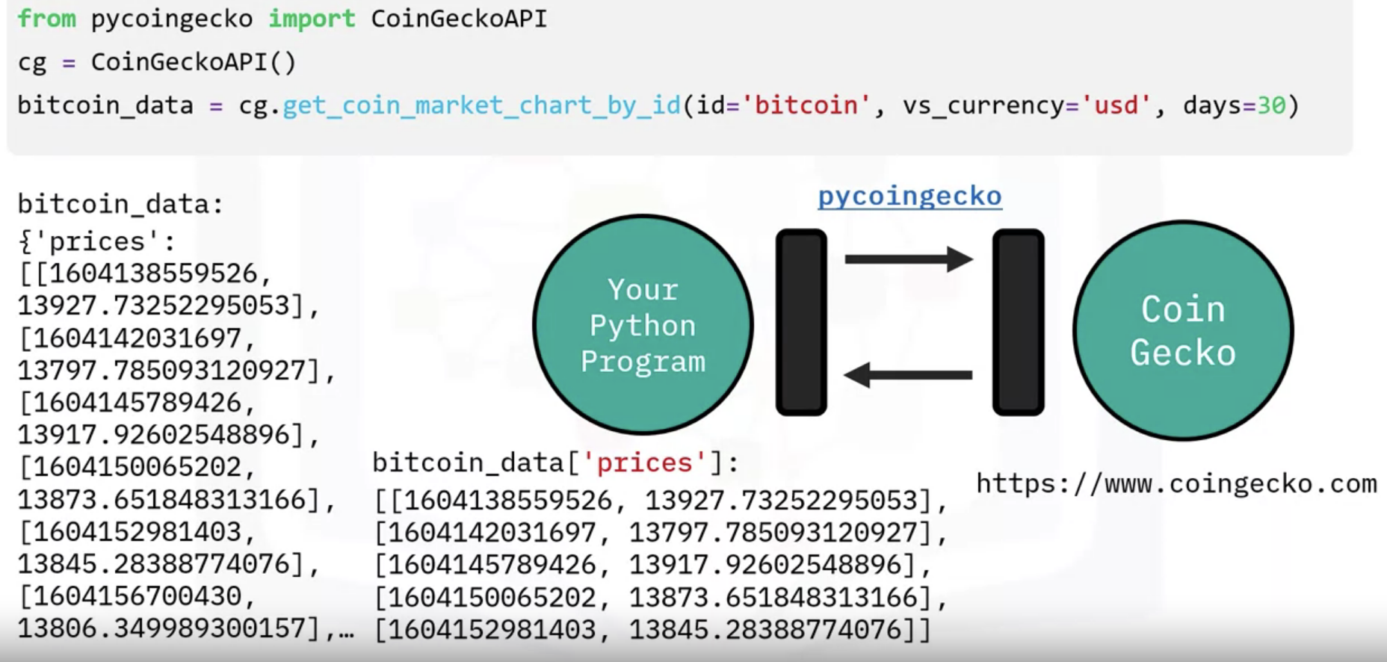
We used the PyCoinGecko Python client or wrapper for the Coin Gecko API, updated every minute by CoinGecko.
install and import the library, then create a client object, and finally, use a function to request our data.
In this function we are getting data on bitcoin, in US Dollars, for the past 30 days. In this case our response is a JSON expressed as a Python dictionary of nested lists
including price, market cap, and total volumes which contain the Unix timestamp and the price at that time.
From the DF (DataFrame/dict) we only need value of prices column/key.

Slide 8
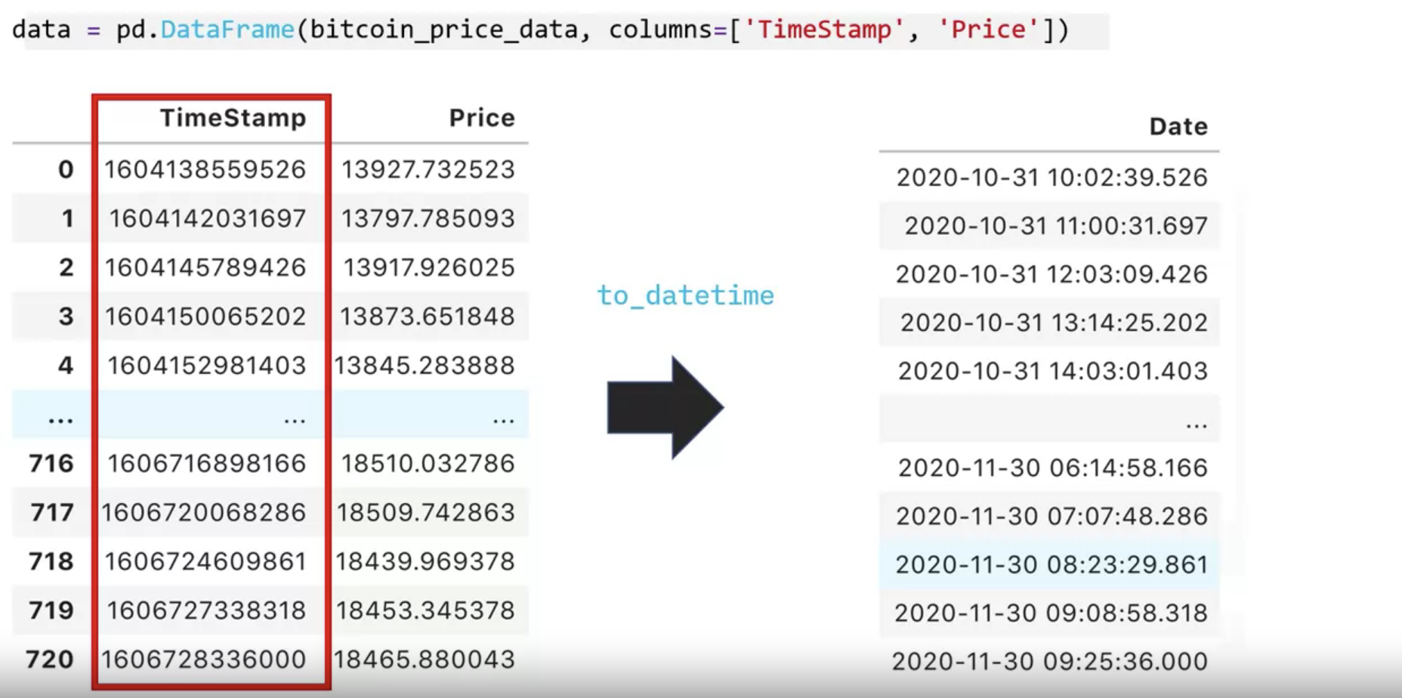
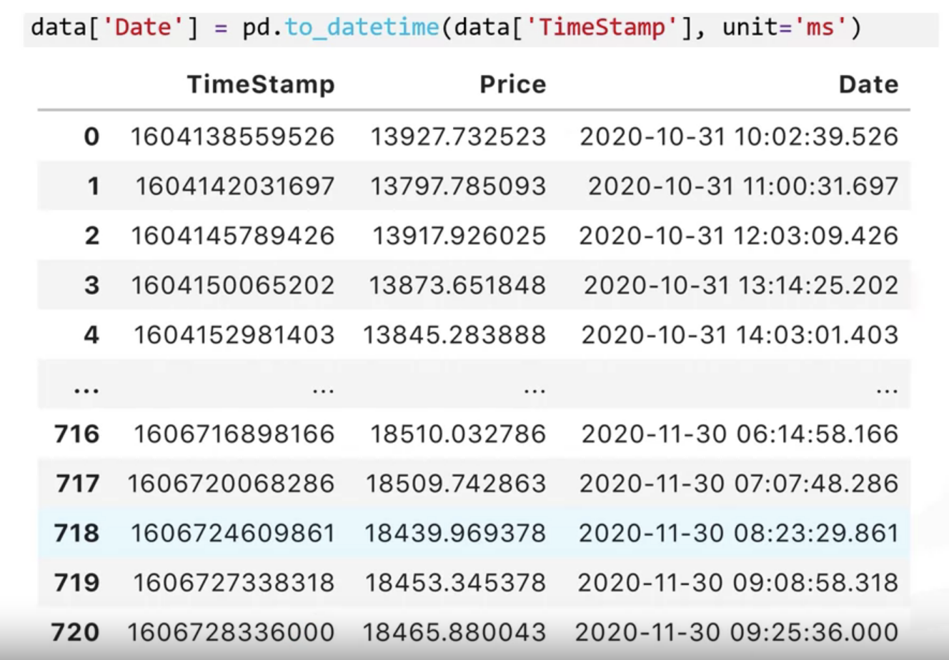
Using pandas function ‘to_datetime’ convert time stamp into readable format.

Slide 9
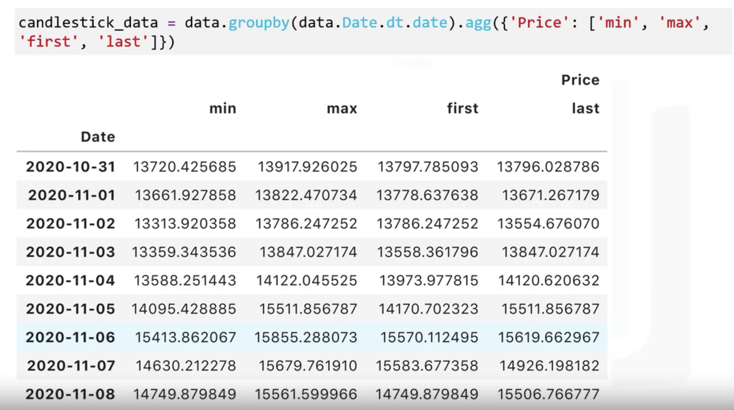
Creating a candlestick chart to monitor Bitcoin prices

Slide 10
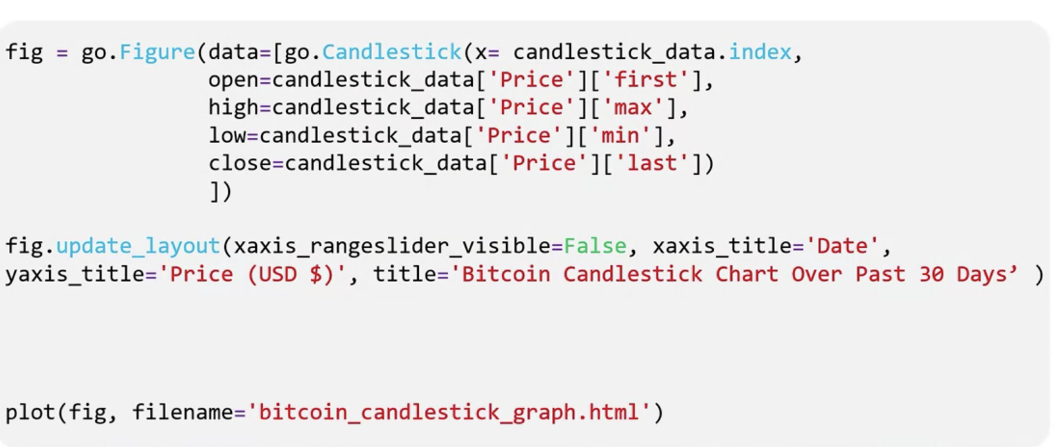
Plotting chart using Plotly

Slide 11
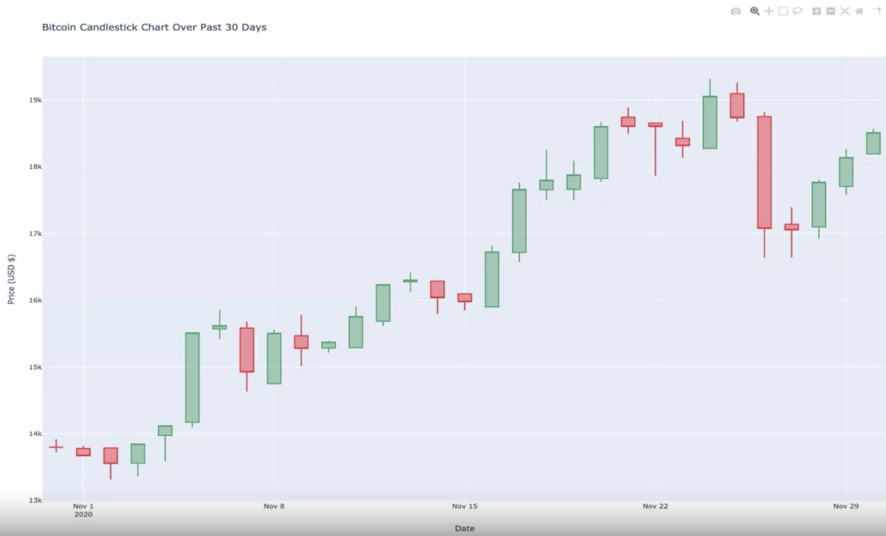

Slide 12
API
APIs with Python/Pandas
Part 2

Slide 13
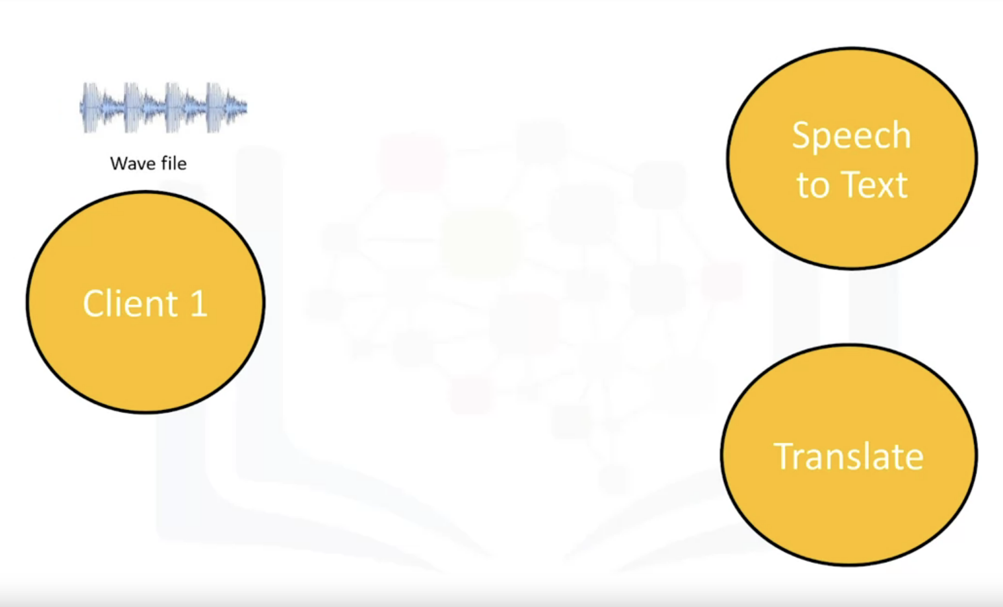
Audio Transcriber- Text to speech API
discuss Application Program Interfaces that
use some kind of artificial intelligence.
We will transcribe an audio file using
the Watson Text to Speech API.
Calient to API : GET request
API to client : POST request/answer
Outline:
API keys & Endpoints
Watson Speech to text
Watson translate

Slide 14
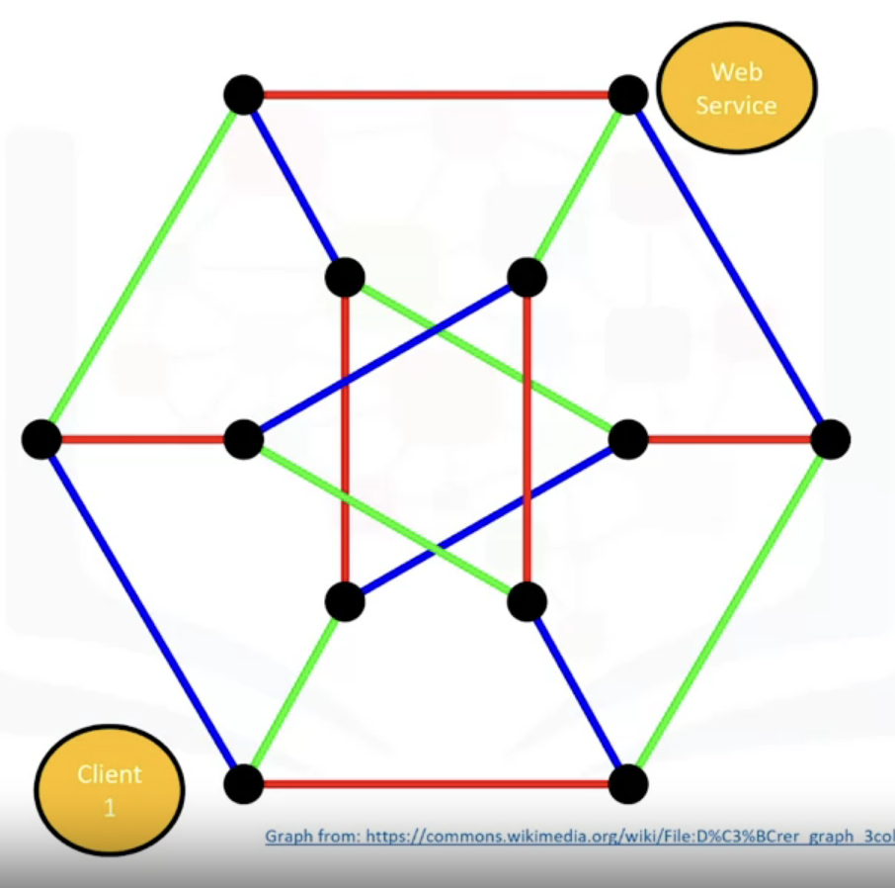
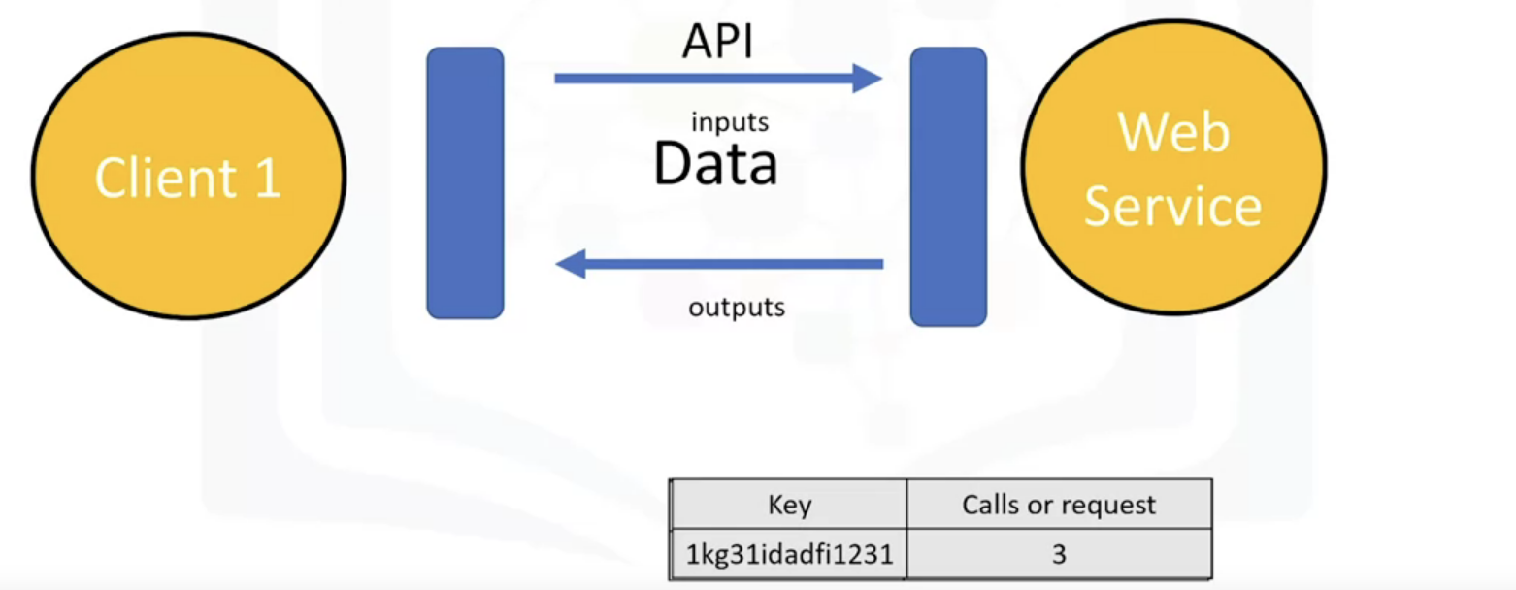
API Keys & Endpoints
Unique set of characters/keys which allows access of the APIs
We mights be charged for the number of calls we make to the API.
An endpoint is simply the location of the service.
It's used to find the API on the Internet just like a web address.

Slide 15
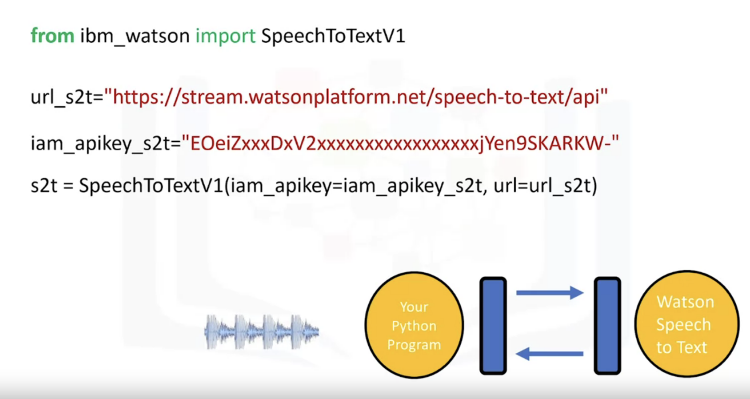
The service endpoint is based on the location of the service instance. We store the information in the variable url_s2t.To find out which URL to use, view the service credentials. You will do the same for your API key. You create a speech-to-text adapter object. The parameters are the endpoint and API key. You will use this object to communicate with the Watson Speech to Text service.

Slide 16
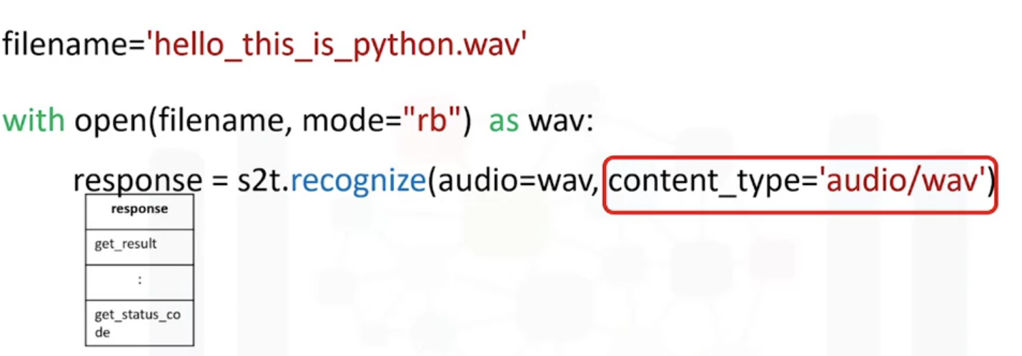
We have the path of the wav file we would like to convert to text. We create the file object wav with the wav file using open. We set the mode to rb, which means to read the file in binary format. The file object allows us access to the wav file that contains the audio. We use the method recognize from the speech to text adapter object.

Slide 17
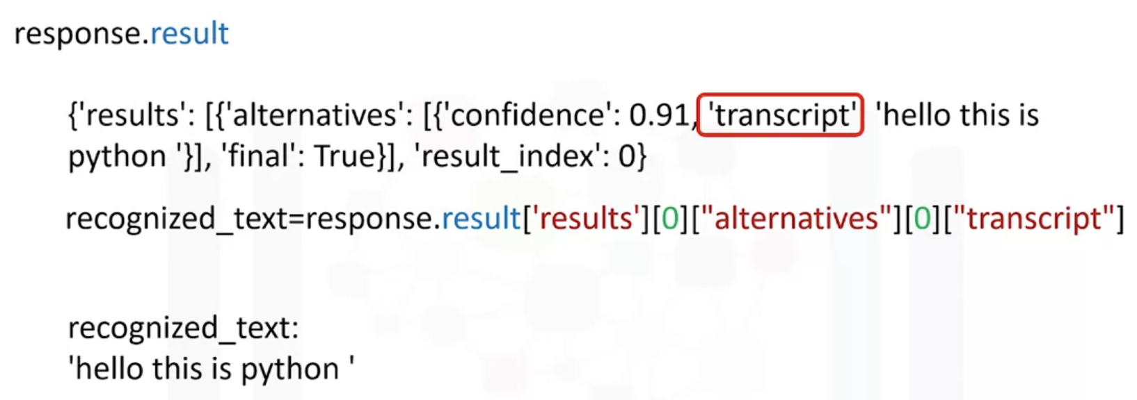
This basically sends the audio file to Watson Speech to Text service. The parameter audio is the file object.
The content type is the audio file format. The service sends a response stored in the object response. The attribute result contains a python dictionary

Slide 18
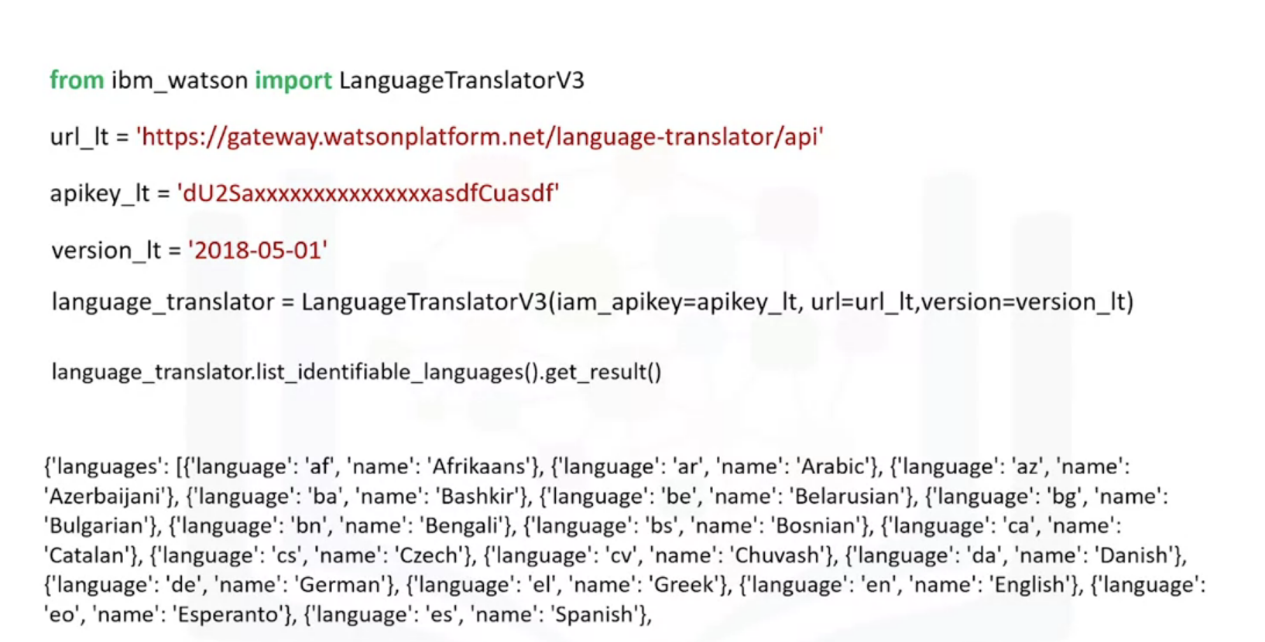
Translating Audio WAV file

Slide 19
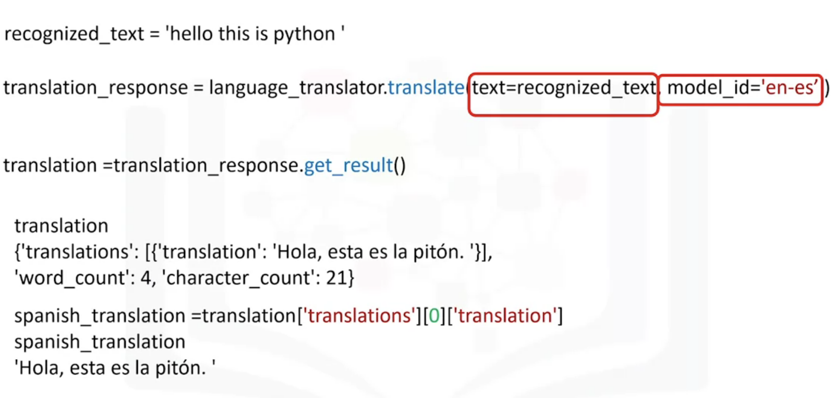
English to spanish

Slide 20
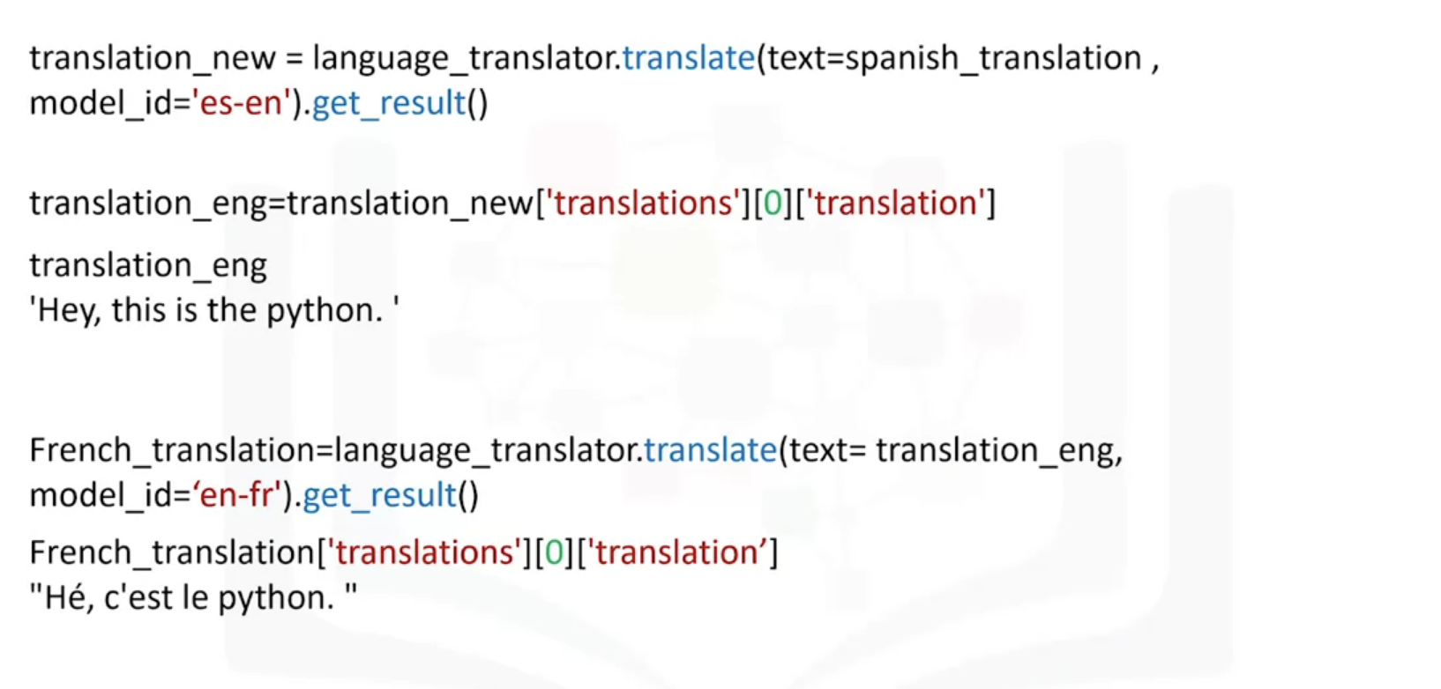
Translating back to English or French

Slide 21
NEXT VIDEO

Slide 22
REST API, Web Scraping & Working with different File Formats
REST APIs & HTTP Requests – Part 1

Slide 23
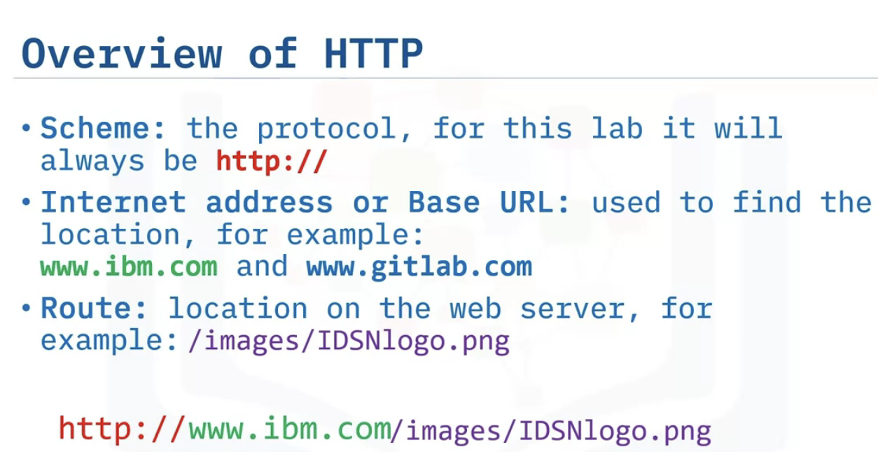
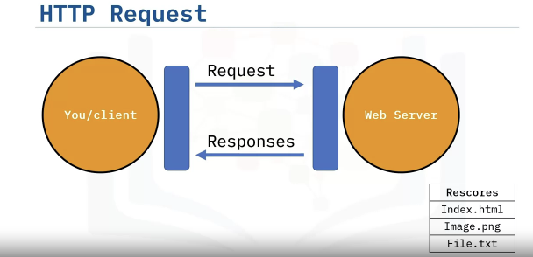
HTTP Protocol & its Overview
URL : Uniform resource Locator , Client –Requests, Web Server- Responses
Requests are served through HTTP protocol which provides JSON format object as response.

Slide 24
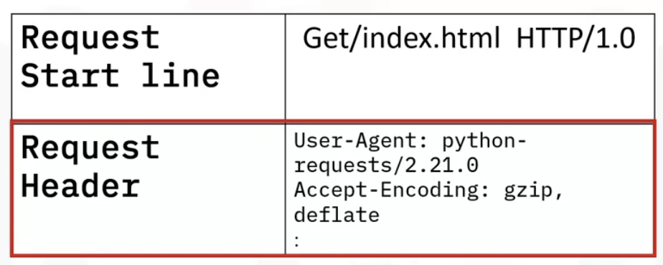
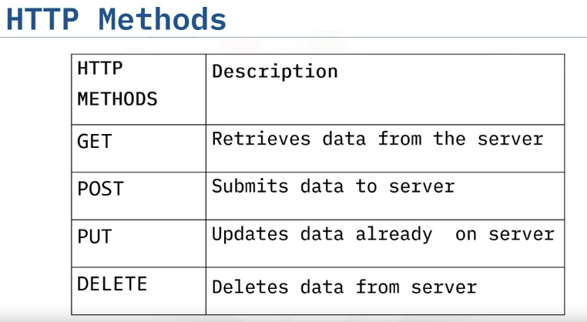
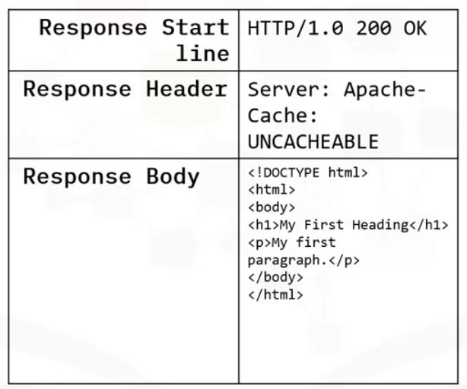
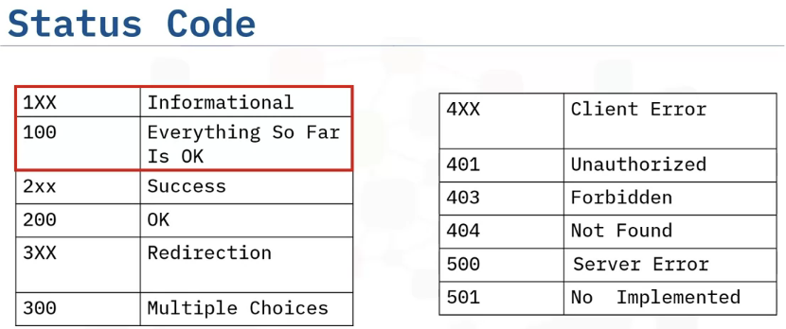
Request Message

Slide 25
REST API, Web Scraping & Working with different File Formats
REST APIs & HTTP Requests – Part 2

Slide 26
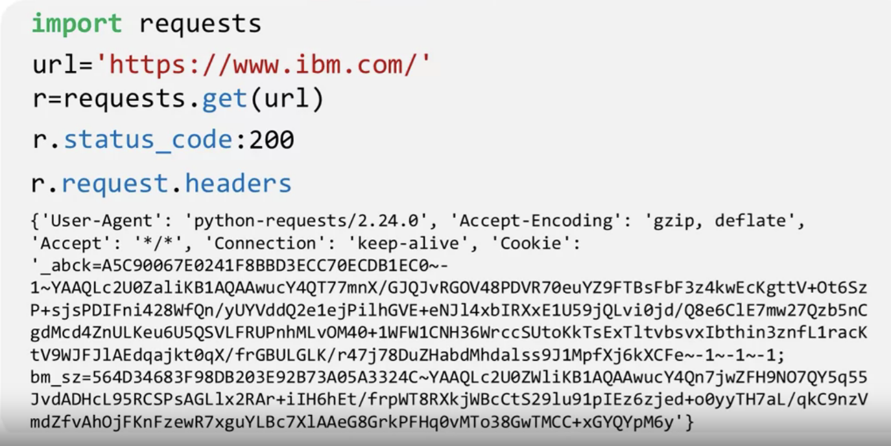
HTTP using Requests Library in Python
Outline : Requests in Python, GET requests, Post requests
Requesting IBM page
Status code=200, page is OK , and requesting headers

Slide 27
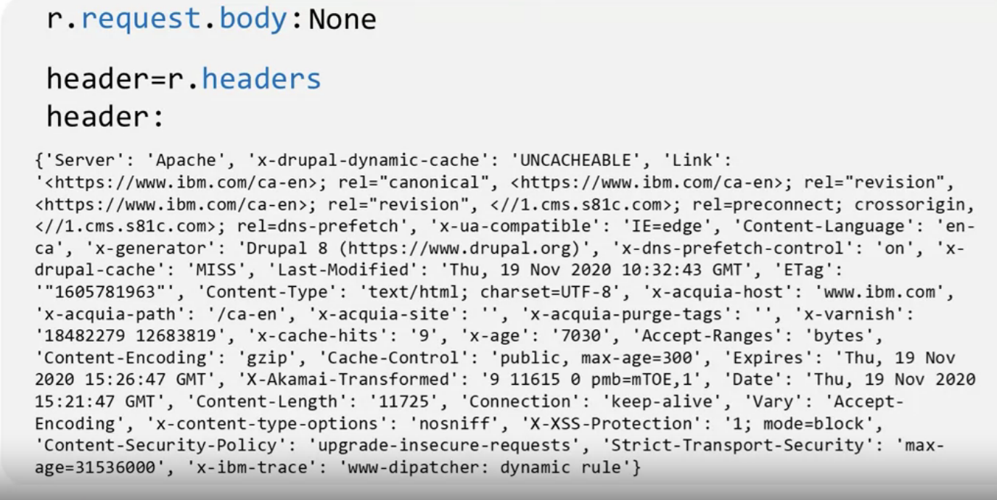
Receiving response as a dictionary

Slide 28
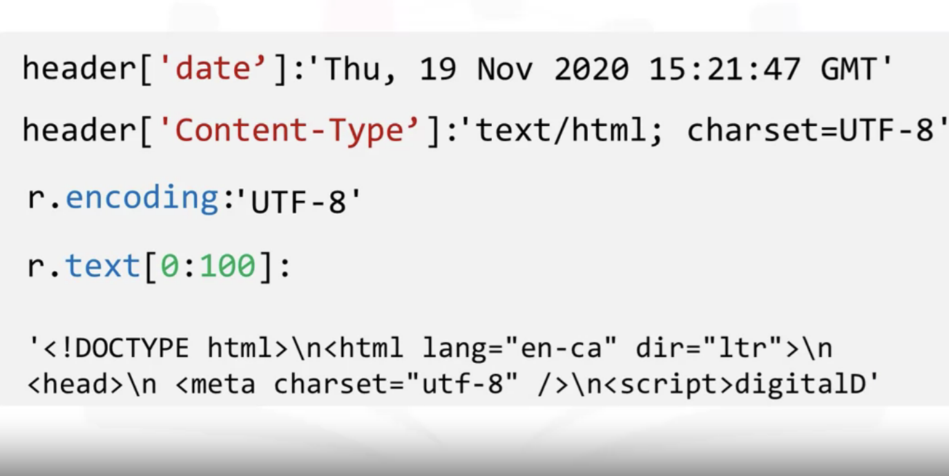
r.text[0:100] = reviewing the first 100 characters,
UTF-8= variable-length character encoding standard used for electronic communication

Slide 29
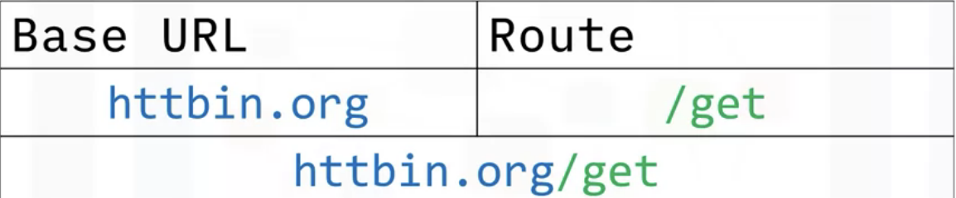
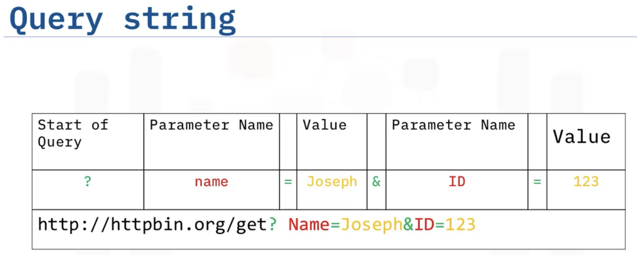
GET Request
As a part of a GET request we receive a Query string

Slide 30
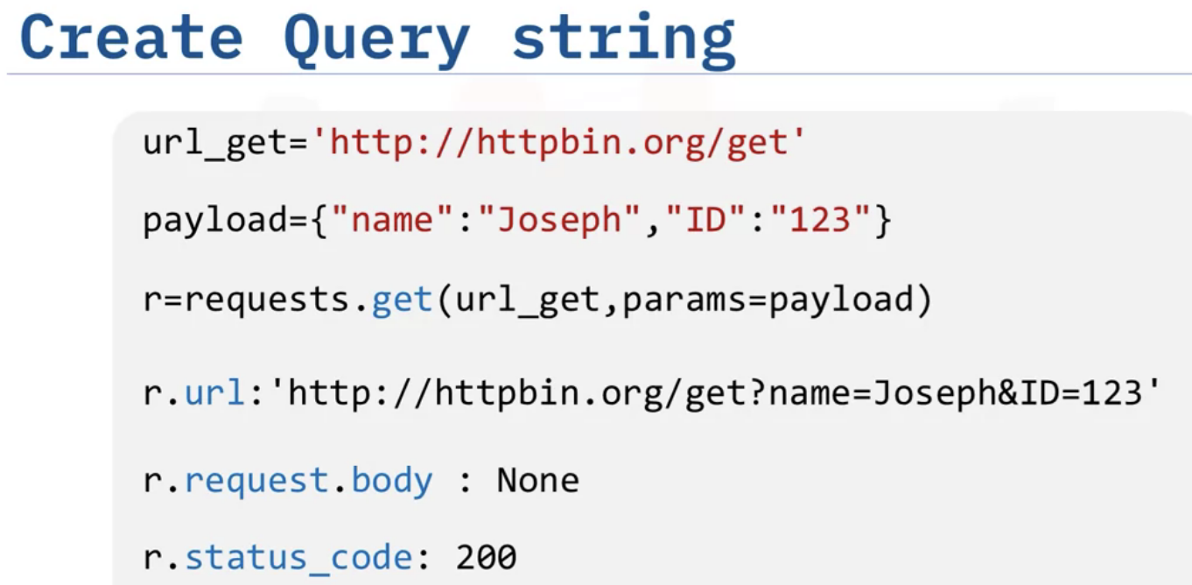
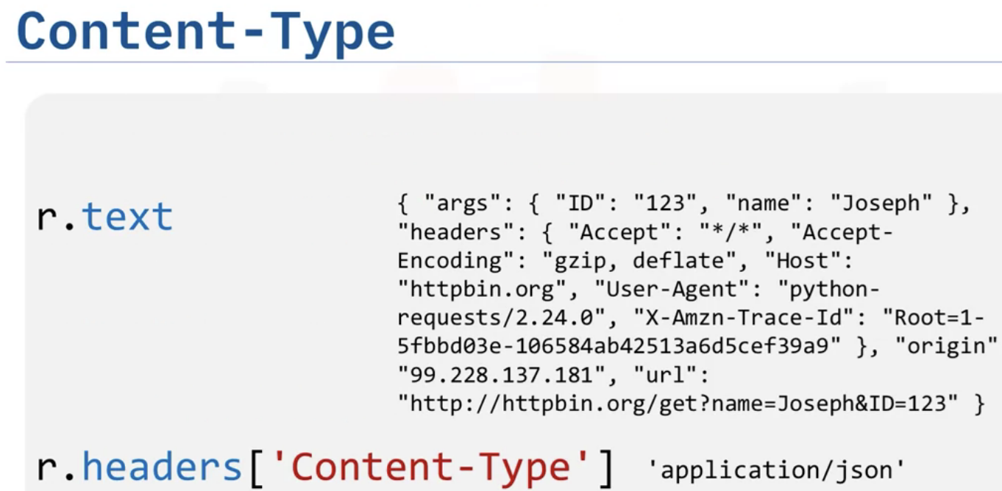
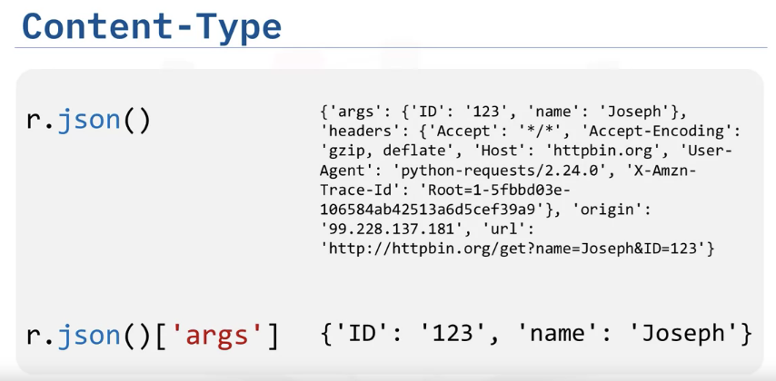
We can explore JSON Dictionary arguments as below

Slide 31
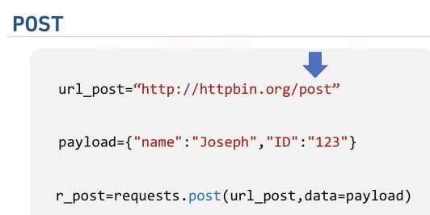
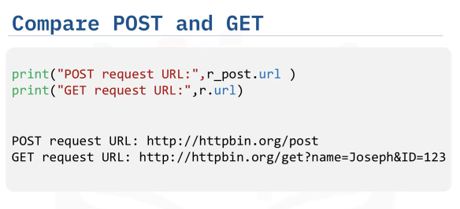
POST Request
Chnaging route to post in order to make a POST request
Comparing GET & POST request, there is no Name or Value Pair in its URL.
We have Payload Dictionry using it, we have to use
POST function

Slide 32
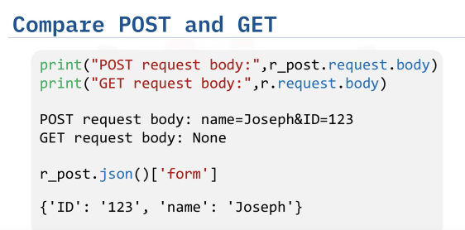

Slide 33
Python Pillow - Using Image Module - GeeksforGeeks

